Slide 1

ICSE 2022

Slide 2
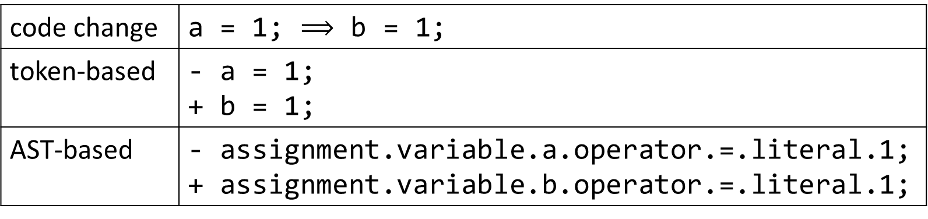
Limitations of previous techniques
They represent the code changes by simply putting old version and new version together without explicit highlighting fine-grained edit operations.
They mainly focus on coarse-grained tokens without explicitly and individually describing finer-grained tokens.
code change | a = 1; $⟹$ b = 1;
token-based | - a = 1; + b = 1;
AST-based | - assignment.variable.a.operator.=.literal.1; + assignment.variable.b.operator.=.literal.1;

Slide 3
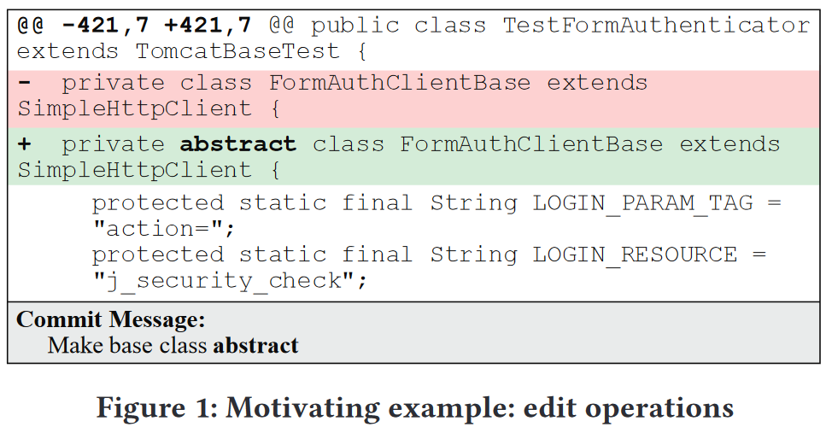
Limitations of previous techniques

Slide 4
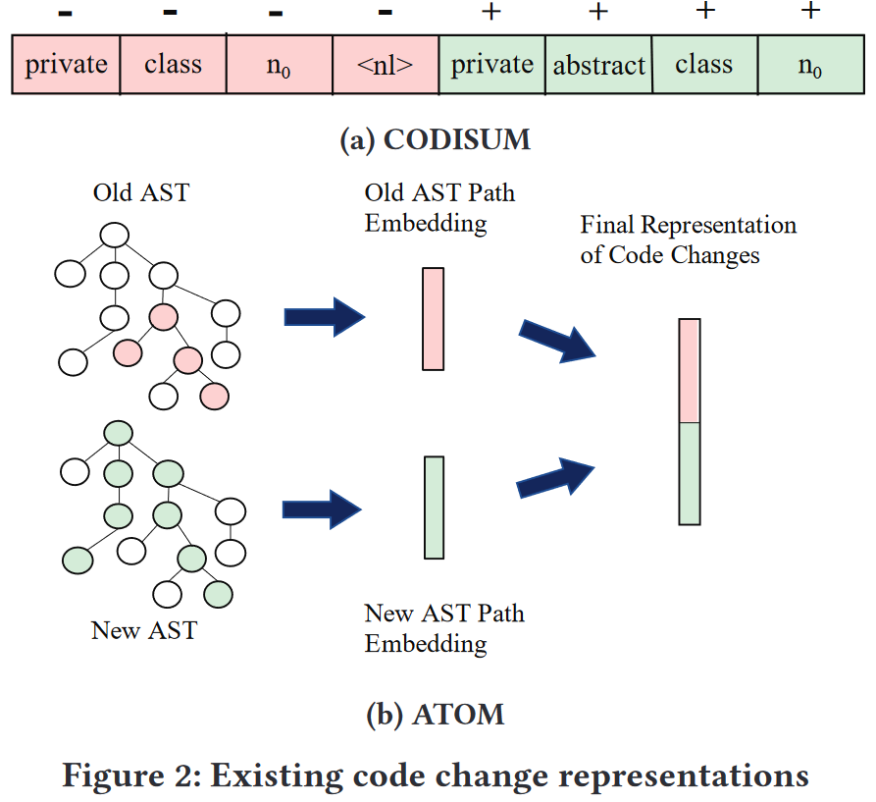

Slide 5
Limitations of previous techniques
They represent the code changes by simply putting old version and new version together without explicit highlighting fine-grained edit operations.
They mainly focus on coarse-grained tokens without explicitly and individually describing finer-grained tokens.
code change | ... setMinimumSize ...
commit message | ... set minimum size ...

Slide 6
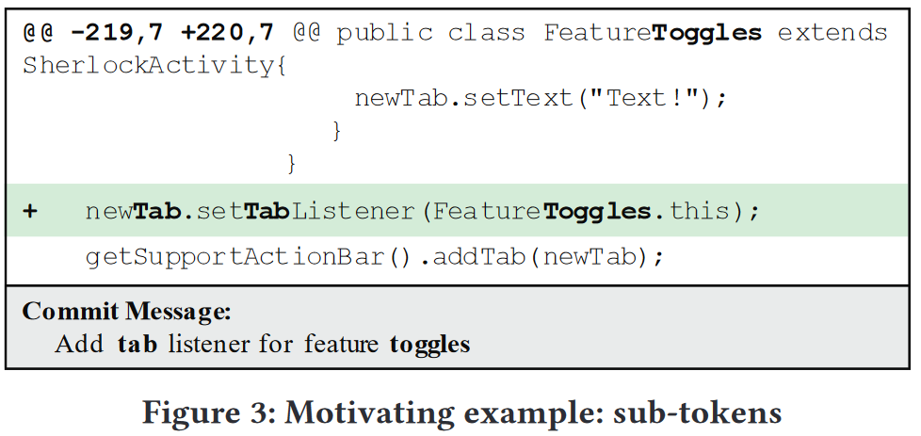
Limitations of previous techniques

Slide 7
Code Change Representation
Graph construction:
Building chopped ASTs.
Adding sub-tokens.
Annotating edit operations.
Incorporating additional sequential information.

Slide 8
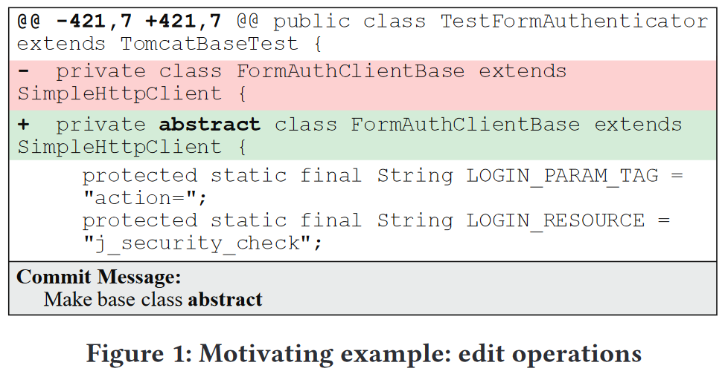
Code Change Representation

Slide 9
Code Change Representation
Building chopped ASTs.
Previous techniques often represent all the changed code together. CODISUM concatenates all deleted/added hunks as a sequence; ATOM always constructs AST of the entire file.
FIRA constructs ASTs at hunk level.

Slide 10
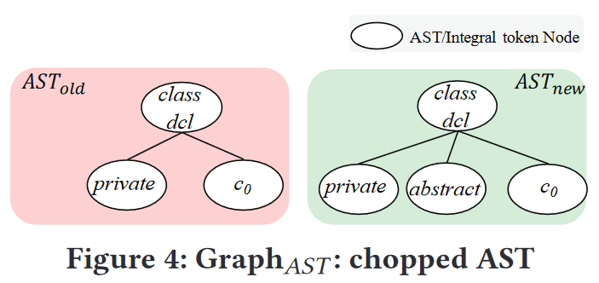
Code Change Representation
Building chopped ASTs.

Slide 11
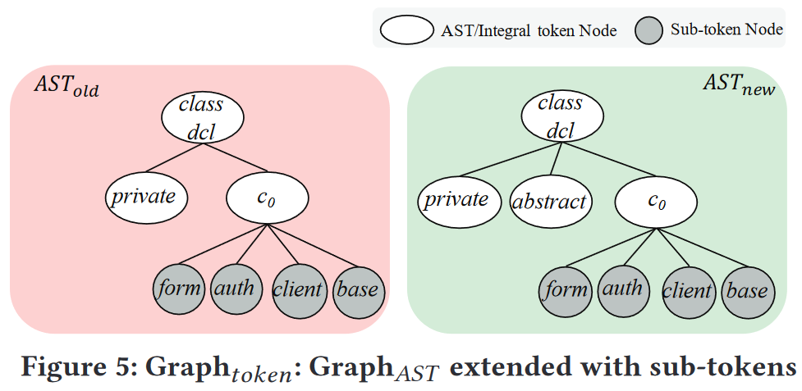
Code Change Representation
Building chopped ASTs.
Adding sub-tokens.

Slide 12
Code Change Representation
Building chopped ASTs.
Adding sub-tokens.
Annotating edit operations.
Add nodes that represent edit operations on the graph:
v_{ADD}, v_{DEL}, v_{MOVE}, v_{UPDATE}, and v_{MATCH}.

Slide 13
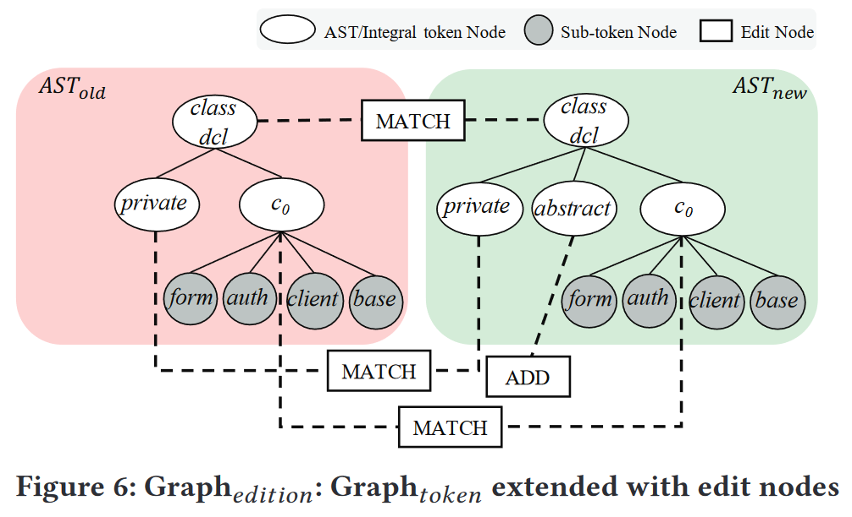
Code Change Representation
Building chopped ASTs.
Adding sub-tokens.
Annotating edit operations.

Slide 14
Code Change Representation
Building chopped ASTs.
Adding sub-tokens.
Annotating edit operations.
Incorporating additional sequential information.
Previous work suggest that the sequential information can be helpful.

Slide 15
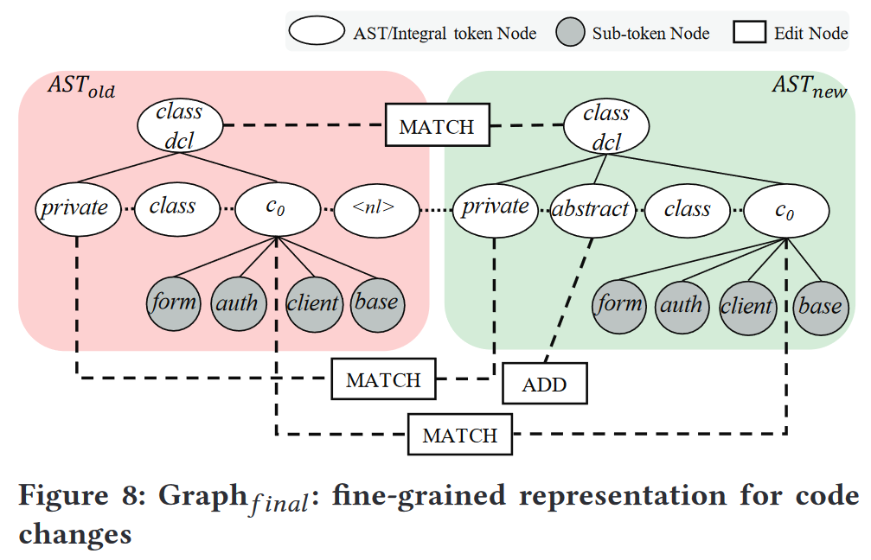
Code Change Representation
Building chopped ASTs.
Adding sub-tokens.
Annotating edit operations.
Incorporating additional sequential information.

Slide 16
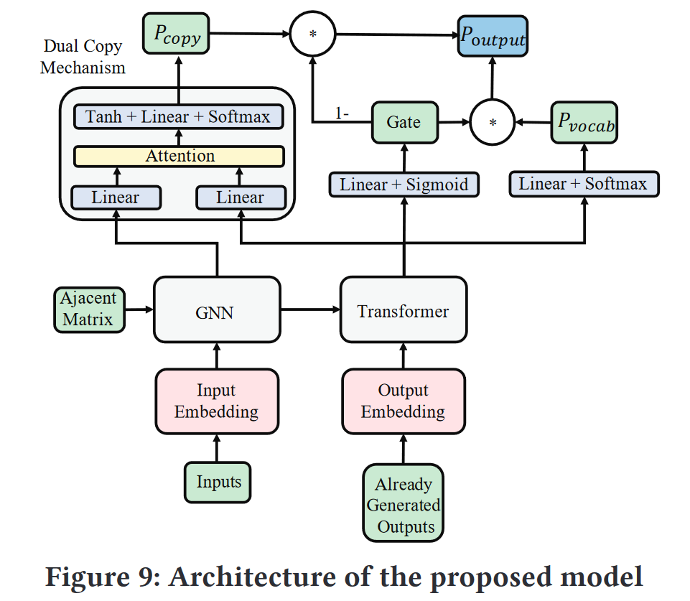
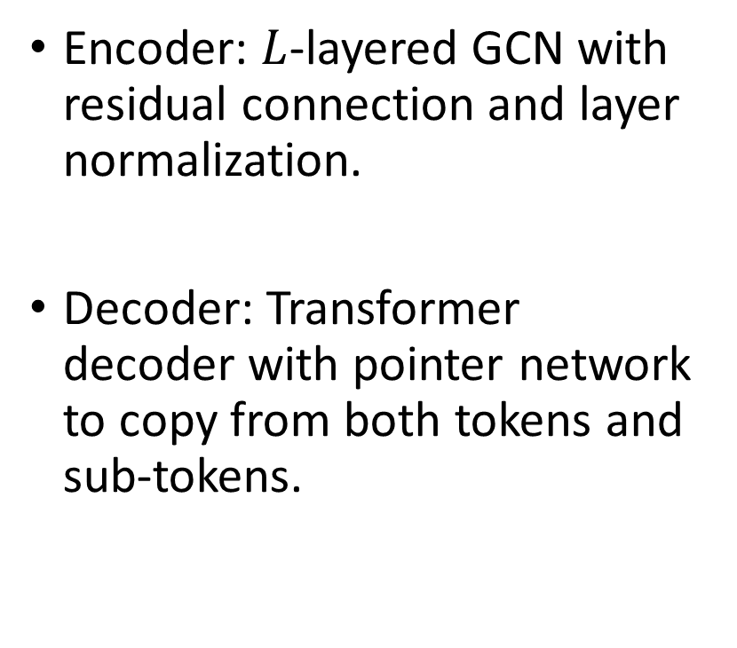
Model Architecture
Encoder: $L$-layered GCN with residual connection and layer normalization.
Decoder: Transformer decoder with pointer network to copy from both tokens and sub-tokens.

Slide 17
Evaluational Setups
Dataset: the well-established benchmark, based on top 1000 popular Java projects in GitHub. Size: 90661 pairs of commits and relevant commit messages. Division: 75k for training, 8k for validation, 7.611k for testing.
Config:
max size of input graph: 650 (370 code nodes, 280 edit nodes).
decoding length: 30.
hidden size: 256.
6-layer GNN with 0.2 dropout rate
6-layer 8-head Transformer with 0.1 dropout rate

Slide 18
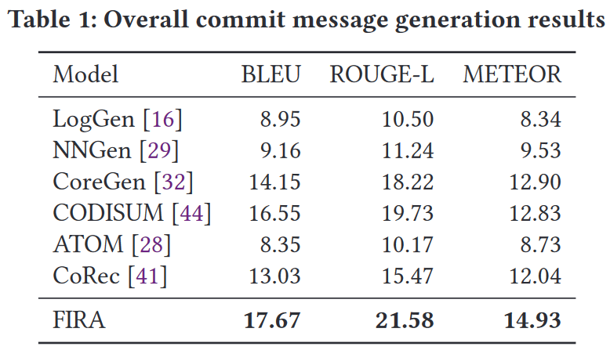
Experimental Results and Analysis
RQ1: Overall effectiveness. How does FIRA perform compared to the SOTA techniques?

Slide 19
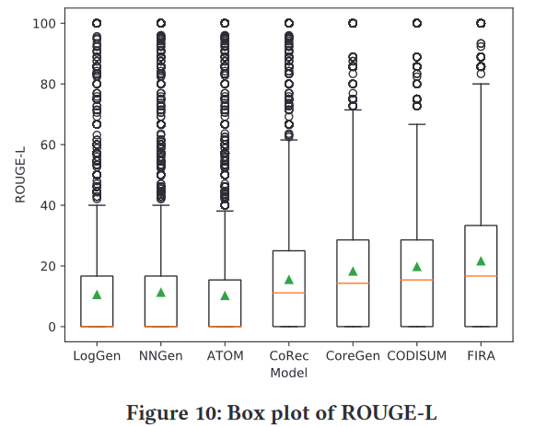

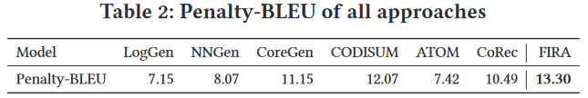
Experimental Results and Analysis
RQ1: Overall effectiveness. How does FIRA perform compared to the SOTA techniques?

Slide 20
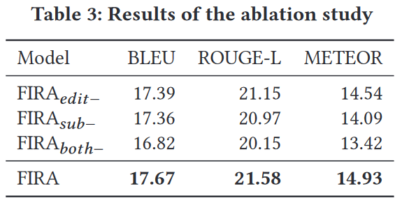
Experimental Results and Analysis
RQ2: Ablation Study. How does each component of FIRA contribute to the effectiveness?

Slide 21
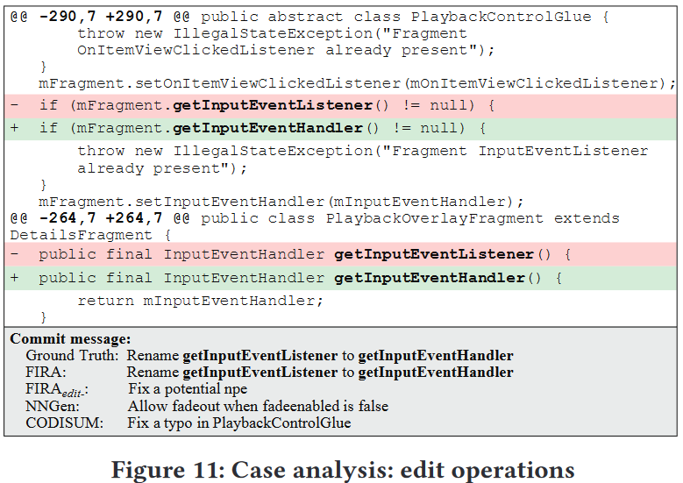
Experimental Results and Analysis
RQ2: Ablation Study. How does each component of FIRA contribute to the effectiveness?

Slide 22
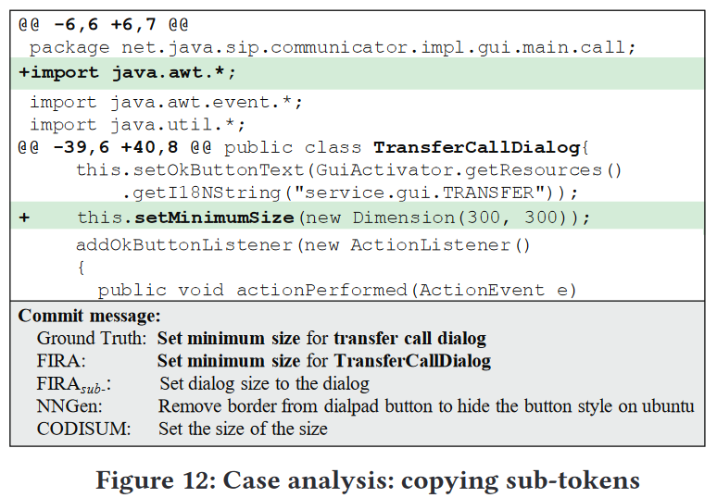
Experimental Results and Analysis
RQ2: Ablation Study. How does each component of FIRA contribute to the effectiveness?

Slide 23
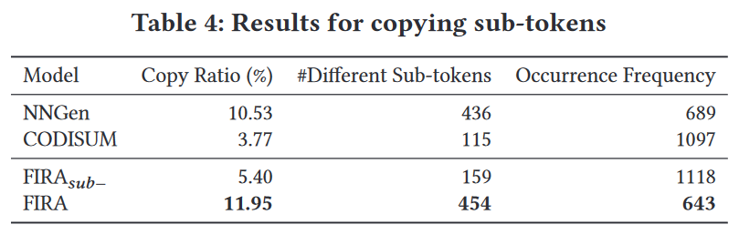
Experimental Results and Analysis
RQ2: Ablation Study. How does each component of FIRA contribute to the effectiveness?

Slide 24
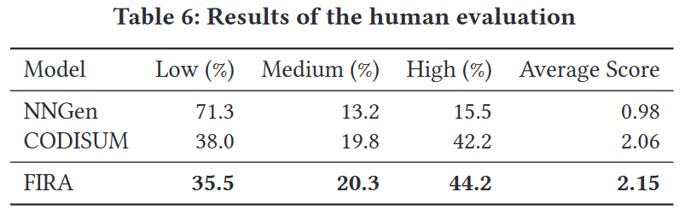
Experimental Results and Analysis
RQ3: Human Evaluation. How does FIRA perform from the perspective of developers?

Slide 25
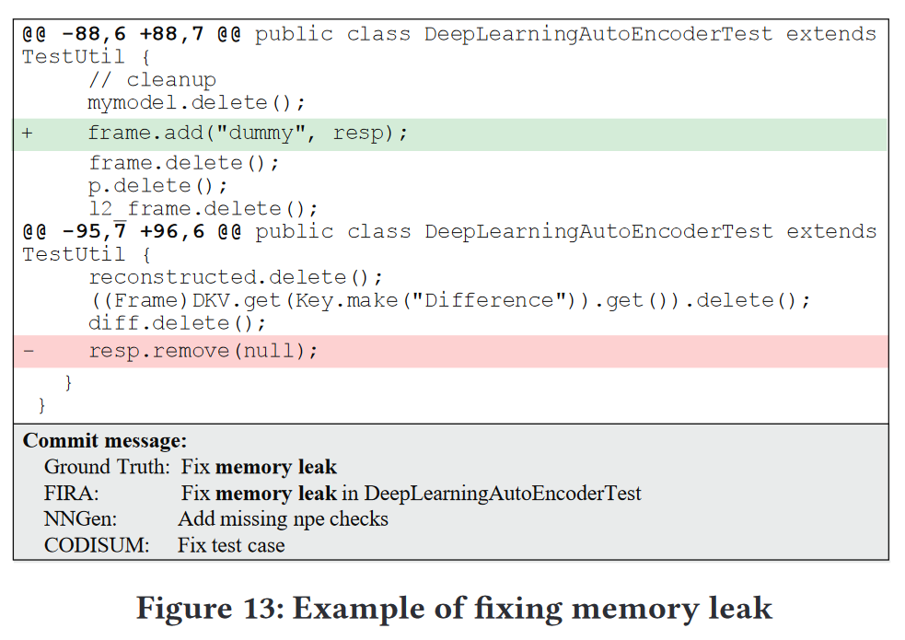
Experimental Results and Analysis
RQ3: Human Evaluation. How does FIRA perform from the perspective of developers?

Slide 26
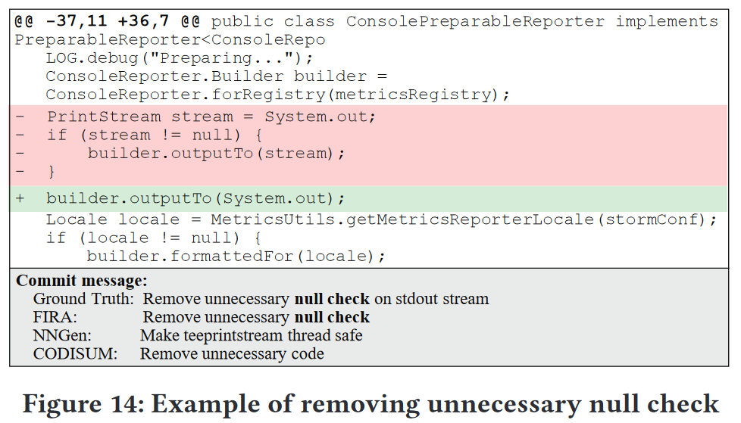
Experimental Results and Analysis
RQ3: Human Evaluation. How does FIRA perform from the perspective of developers?

Slide 27
Conclusion

